Slide 1
Sunset Elementary
New Families Event
November 1, 2023
This Photo by Unknown Author is licensed under CC BY-SA

Slide 2
Sunset Staff:
92 Sunset Staff members on any given day
Kindergarten- Adams, Montgomery, Pacheco, Skroch
G1- Atkinson, Bland, Connolly, Edwins, McKenny
G2- Allen, Arthur, Blastos, Bundy, Porter
G3- Cress, Heggestad, Keen, Rodabough
G4- Doshi, Espino, Jain, Luke/Pierce
G5- Bachman, Brunson, Decorah, Merrill
LRC- Valvis, Rueter, Katz, Haroutoonian, Craig
Specialists- Wright, Dydell/Thomas, Bean/Johnson
Support Staff- Counselors, MTSS/Reading/Math Interventionists, ML, HiCap, OT/PT/SLP, Office, Paraprofessionals, Vision team…
…the list goes on

Slide 3
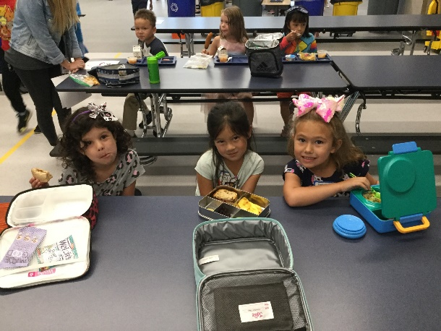
Schoolwide Sockeye Expectations & Celebrations:

Slide 4
Daily Schedule
9:00-9:20 Breakfast
9:05-9:15 Student entry
10:45-11:00 Recess - K & G3
11:30-12:10 Recess/Lunch – G1 & G4
12:00-12:40 Recess/Lunch – G2 & G5
12:30-1:10 Recess/Lunch – K & G3
2:30-2:45 Recess – G1 & G4
2:45-3:00 Recess - G2 & G5
3:40 Dismissal – staggered by grade level
Wednesday Dismissal @1:30

Slide 5
Arrival/Dismissal:
Stay with students until 9am
Families always stay in vehicle
Do NOT block the roundabout/crosswalks
Display dashboard sign (dismissal(
Students exit curbside/passenger side
Pull all the way to the top of the loop
Always use crosswalks
Walkers/wheels meet families at bike rack
Arrive at staggered dismissal time
Pet-free campus

Slide 6
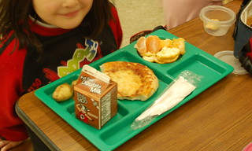
Breakfast
9:00-9:15 with grab and go until 9:20
$2.50 unless part of free & reduced program (apply at MySchoolApps.com)
Use MySchoolBucks or send a check (sign up at myschoolbucks.com)
Notification via email when balance is below $5.00
Students memorize 5-digit pin #
Lunch
$4.00 unless part of free & reduced program(apply at MySchoolApps.com)
Use MySchoolBucks or send a check (sign up at myschoolbucks.com)
Notification via email when balance is below $5.00
Students memorize 5-digit pin #
Power Packs
MENU

Slide 7
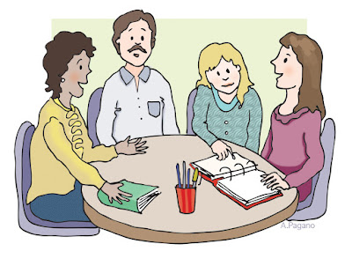
Conferences: Nov 8 & Nov 9
Honor time – arrive on time / stay for designated time
Peek inside to make sure teacher is ready (not with another family)
Share a positive about your student or school
Express any concerns
Bring questions you have on a sticky note
Plan on partnering around concerns
Conference Scheduler closed today
View only now, can only see time signed up for
If still need a time, you must call the teacher

Slide 8
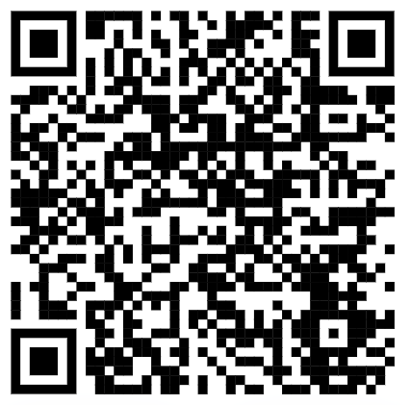
ISD Clearance: apply here
Classrooms & Events
VOICE
PTA- check the PTA website
WEATHER- Sign up for ISD and Sunset communication by opting in for text messages

Slide 9
Table Talk: 10m & Share Out: 10m
What are you wondering about?
What have you noticed so far?
What would you like to learn more about on February 7, 2024?

